Slide 1

Analysts Briefing
1H 2023 FINANCIAL AND OPERATING RESULTS

Slide 2
1H 2023 Highlights
Philex generated Php702 million core net income for 1H2023 compared to Php1.333 billion in 1H2022.
  Operating Revenues are lower at Php2.051 billion in 2Q2023 compared to Php2.485 billion in 2022
  Reported net income is at Php704 million.
2Q2023 Core Net Income at Php314 million compared to Php657 million in 2Q2022
Core EDITDA of Php1.188 billion for 1H2023 lower by 50% than Core EBITDA of Php2.353 billion for 1H2022
Gold prices improved by 6% while Copper dipped by 7% in 2Q2023 versus 2Q2022 level
Silangan east decline portal completed and tunnel works towards the ore body goes full swing
2

Slide 3
Production Performance
Tonnes Milled: 2Q2023 tonnage higher than 1Q2023 but slightly lower than 2Q2022 as a result of unscheduled repairs and maintenance works of ageing mill equipment
Metal Prices: Sustained higher gold prices and forex helps alleviated the impact of lower metal output
3

Slide 4
Financial Highlights
Operating Revenues:
  Favorable metal prices and forex continued to keep the level of revenues and core net income at profitable levels.
Core Net Income
  2Q2023 Core Net Income lower than 2Q2022 by 52% due to lower metal output
  1H2023 Core Net Income of Php702 million, 47% lower than 1H2022 of Php1.333 billion

Slide 5
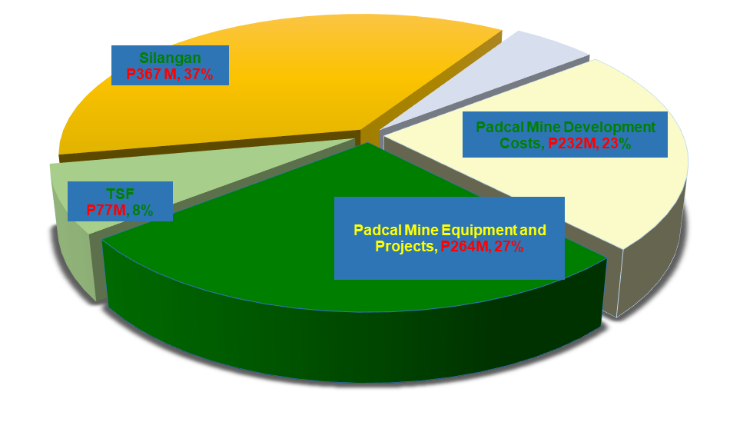
Capital Expenditures
1H 2023 Capex of Php994 million spent on Padcal’s sustaining capex for mine development, new equipment and tailings storage facility works
Silangan Project:
  Construction of the east decline portal has been completed and tunneling works towards the ore body goes full swing.
5

Slide 6
Balance Sheets
Total Assets: Silangan Project as the main asset of the Company to maintain business continuity.
  Deferred Exploration Cost for Silangan Project accounts for 61% of Total Assets
Loans and bonds payable: Continue to reassess loan repayment program to preserve internally-generated cash for the development of Silangan
6

Slide 7
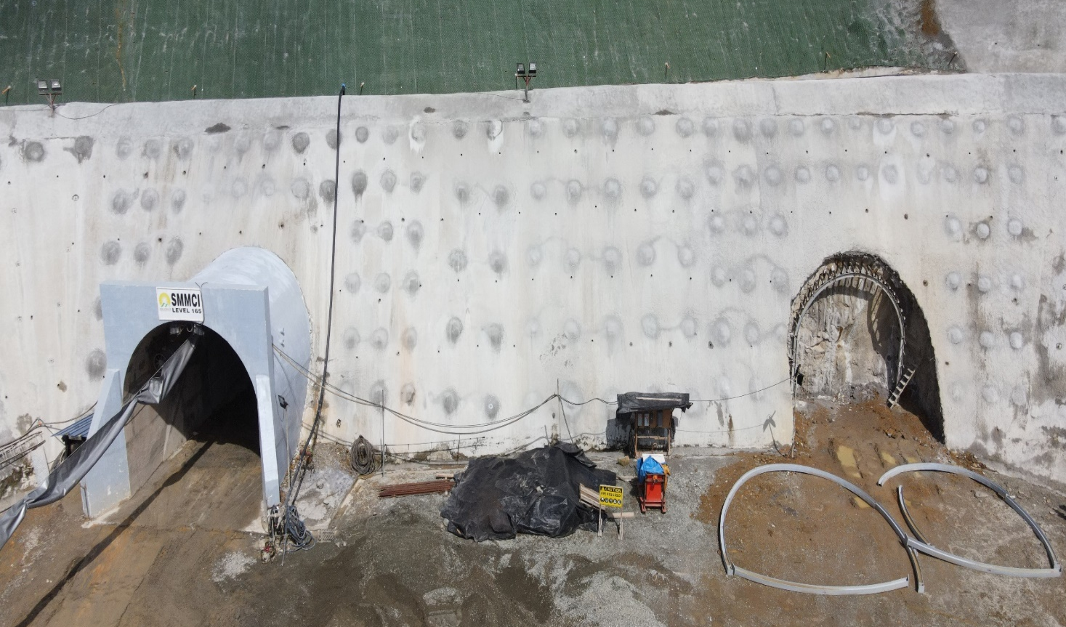
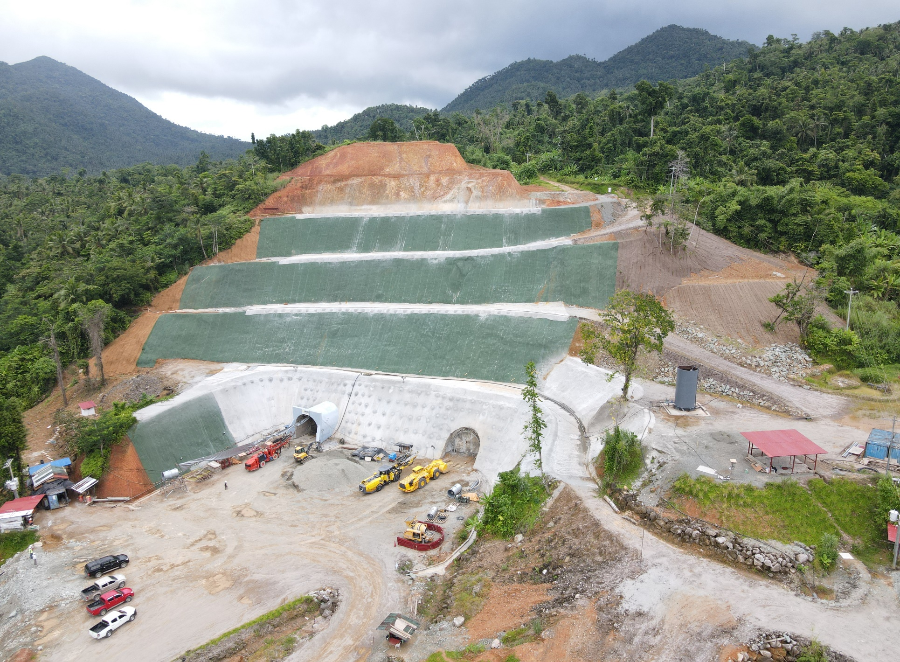
PROJECT SITE UPDATES
MINE ACCESS (DECLINE) DEVELOPMENT
As of June 8, 2023
As of July 20, 2023
East Portal
Vent Pad
As of July 16, 2023
Boxcut
Boxcut
East Portal
West Portal
Mine Development
  Boxcut excavation and slope stabilization completed mid-April 2023
  Decline driving status:
  Completed concreting of 9m span
  2nd hand Face Drill and LHD on site
  West Portal and Decline to be advanced for safety considerations
Design | Actual as of July 20
535m | 19m

Slide 8
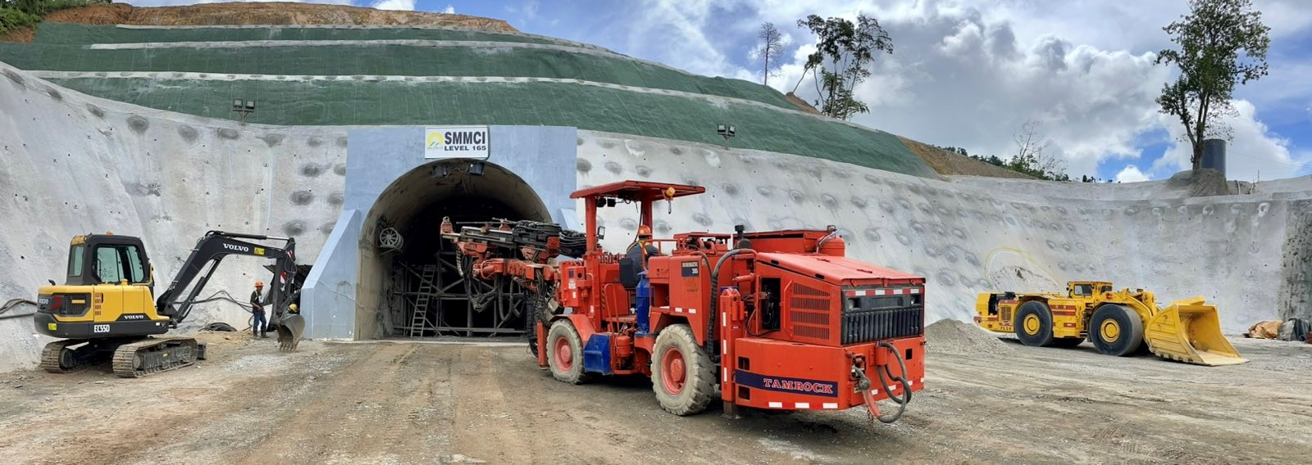
FUNDING DEVELOPMENT
GEARED UP FOR
MINING OPPORTUNITIES

Slide 9

9

